Slide 1

NAAN MUDHALVAN PROJECT
-DATA ANALYTICS WITH TABLEAU
PROJECT TITLE-INDIAN FOOD EDA
TEAM MEMBERS
DEEBIKA S
DEEPIKA S
ANDREA ROSHAL B
MOULIKA A K
1

Slide 2
INTRODUCTION
PROJECT OVERVIEW
The aim of this project is to perform Exploratory Data Analysis (EDA) on a dataset related to Indian food. Exploratory Data Analysis is a crucial step in data analysis that helps in understanding the dataset, discovering patterns, and extracting insights. In this project, we will explore various aspects of Indian cuisine, such as ingredients, recipes, regional variations, and popularity.
PURPOSE
The project aims to analyse different Indian dishes and infer about the time taken for preparing each dish with help of Exploratory Data Analysis (EDA) on a dataset created based on Indian food varieties, thus pictorially representing the preparation process as slow, medium, and fast.
LITERATURE SURVEY
EXISTING PROBLEM
Despite the growing popularity of Indian cuisine worldwide, there is a lack of comprehensive data-driven insights into the consumption and preferences for Indian food, both domestically and internationally. The existing data sources are often fragmented and outdated, making it challenging for restaurants, food businesses, and culinary enthusiasts to make informed decisions about menu planning, marketing strategies, and ingredient sourcing. This knowledge gap hinders the ability to cater to the diverse tastes and preferences of consumers who enjoy Indian food. Therefore, the problem is to conduct an EDA to bridge this information gap and provide actionable insights for the Indian food industry.
REFERENCES INTRODUCTION
Exploratory Data Analysis (EDA) has become an essential tool in understanding and extracting insights from large datasets. In the context of Indian food, EDA plays a crucial role in unraveling the complexities of this diverse and rich culinary heritage. This literature review explores existing research and studies that have employed EDA techniques to analyze Indian food datasets, shedding
2

Slide 3
light on the ingredients, regional variations, popularity, and nutritional aspects of Indian cuisine.
DIETARY ASSESSMENT AND INDIAN CUISINE ANALYSIS USING
KNN AND EDA by Pearl Ahuja, Diksha Solani, Amita Goel, Nidhi Sengar, Vasudha Bahl (2021)
Description: In this paper, an exertion has been made to analyse the various food items for assessment of most favoured cuisine in every region of India along with recommendation of various dishes preferable to that region using KNN and EDA.
FOOD NUTRITIONAL ANALYSIS AND EDA by Atishya Mahesh Jain, KrishnaPriya B, Seno Sunil, Helen Grace Jikku, Sheethal Kj (2022)
Description: This project deals with the usage of Exploratory Data Analysis (EDA) in order to carry out nutritional analysis, thus finding the nutrient composition, quality, and contamination of a food variety.
ZOMATO DATA WITH EDA, GEOSPATIAL AND SENTIMENT
ANALYSIS by Priyadharshini R (2021)
Description: The main objective of this project is to find insights and get some idea about the restaurants in Bangalore using different techniques like EDA, Geospatial and Sentiment Analysis.
EDA AND VISUALIZATION OF INDIAN STREET FOOD: A DATA-
DRIVEN PERSPECTIVE by Das and Mohanty (2022)
Description: This study employs EDA and visualization techniques to analyze data on Indian street food. The authors explore the regional variations, popularity, and ingredients of street food across different Indian cities. Through visualizations, they highlight the street food culture and its unique culinary offerings, uncovering hidden gems and trends.
3

Slide 4
EDA OF POPULAR INDIAN DISHES ON SOCIAL MEDIA by Patel and Shah (2020)
Description: This study utilizes EDA to analyze the popularity of Indian dishes on social media platforms. The authors collect data from various social media sources and explore metrics such as user ratings, reviews, and mentions. They identify popular dishes, trends, and emerging flavors, providing insights into the changing preferences of consumers.
2.3. PROBLEM STATEMENT DEFINITION
Conduct an exploratory data analysis (EDA) to gain insights into the consumption, preferences, and trends related to Indian cuisine in a specific geographic area or across a particular demographic group. This analysis aims to provide a comprehensive understanding of the patterns, ingredients, dishes, and factors influencing the popularity and consumption of Indian food, ultimately informing decisions related to restaurant menus, marketing strategies, or culinary innovation within the context of Indian cuisine.
IDEATION AND PROPOSED SOLUTION
EMPATHY MAP CANVAS
DEFINITION:
An empathy map canvas for an exploratory data analysis (EDA) of Indian food can help you understand the perspectives and needs of stakeholders involved in this project. Here is a template of an empathy map canvas tailored for Indian food EDA:
Stakeholder:
List the primary stakeholders or personas involved in the EDA project, e.g., Restaurant Owners, Food Distributors, Food Enthusiasts, Consumers.
4

Slide 5
What They Say:
"We need to understand the emerging food trends in Indian cuisine."
"It's crucial to identify the most popular dishes among consumers."
"Access to reliable data on regional variations can help us tailor our menus."
"We want to know which ingredients are gaining popularity."
What They Think:
"I wonder if our menu needs to be updated to cater to evolving tastes."
"Are there any untapped opportunities in the Indian food market?"
"Can we optimize our supply chain based on data-driven insights?"
"What are the key factors that influence consumer choices in Indian food?"
What They Do:
Conduct market research to gather data on consumer preferences.
Experiment with new Indian food dishes or menu items.
Collaborate with data analysts or researchers for insights.
Adjust marketing strategies based on trends and customer feedback.
What They See:
Increased competition in the Indian food industry.
Changing consumer demographics and preferences.
Varied restaurant and food business models.
The influence of social media and online reviews on food choices.
5

Slide 6
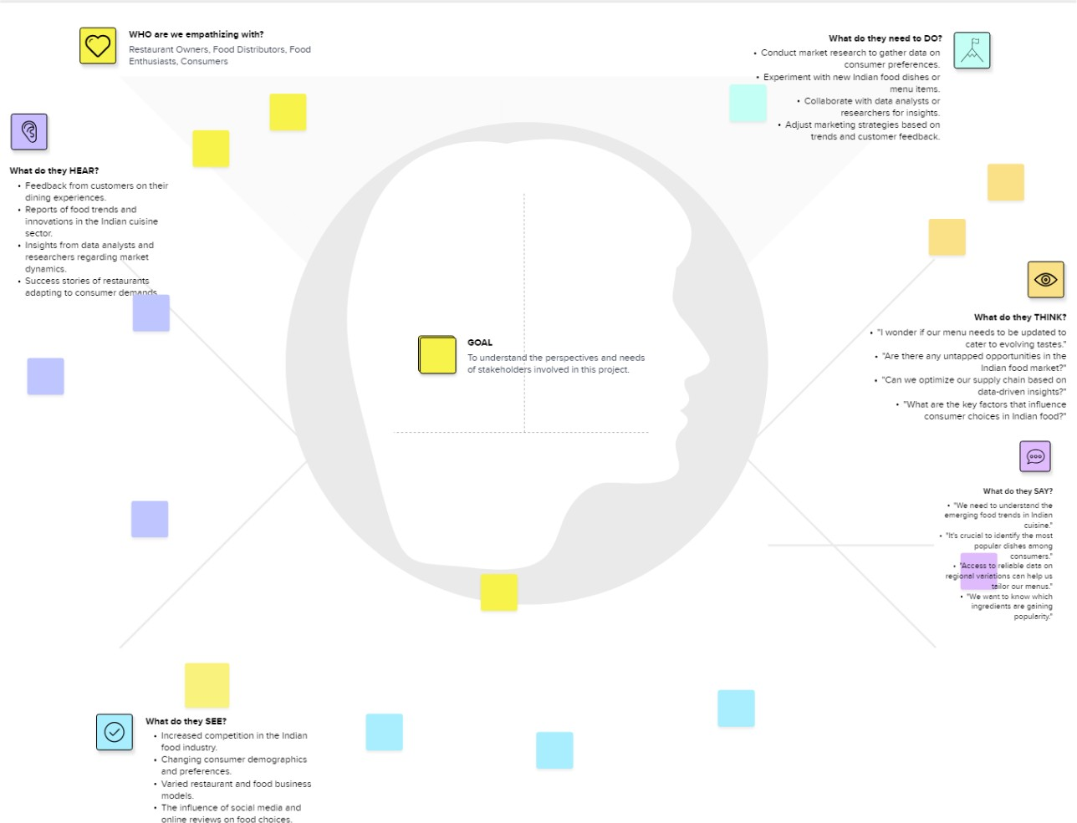
What They Hear:
Feedback from customers on their dining experiences.
Reports of food trends and innovations in the Indian cuisine sector.
Insights from data analysts and researchers regarding market dynamics.
Success stories of restaurants adapting to consumer demands.
AN EMPATHY MAP FOR INDIAN FOOD EDA
6

Slide 7
3.2. IDEATION AND BRAINSTORMING
Ideation and brainstorming for an exploratory data analysis (EDA) of Indian food can help generate ideas, concepts, and potential research directions.
Cuisine Regional Variation Analysis:
Explore regional variations in Indian cuisine and their popularity.
Analyze which regions are known for specific dishes and ingredients.
Ingredient Popularity:
Investigate the popularity of individual spices, herbs, and ingredients in Indian recipes.
Identify trends in ingredient usage over time.
Consumer Preferences and Demographics:
Understand consumer preferences in Indian cuisine.
Analyze how age, location, and cultural background influence food choices.
Health and Dietary Trends:
Investigate the impact of health and dietary trends on Indian food choices.
Examine the rise of vegetarian and vegan options in Indian cuisine.
7

Slide 8
Ingredient Sourcing and Supply Chain:
Study the supply chain and sourcing of ingredients for Indian restaurants and products.
Analyze the impact of global events on ingredient availability and prices.
Food Pairing and Flavor Profiles:
Explore which flavors and ingredients pair well in Indian dishes.
Create data-driven flavor profiles for different types of Indian cuisine.
Innovation and Fusion:
Investigate innovative or fusion dishes in Indian cuisine.
Analyze the adoption of modern cooking techniques in traditional Indian recipes.
Recipe and Cooking Trends:
Analyze the popularity of specific Indian recipes and cooking methods.
Identify emerging cooking trends in Indian cuisine.
Cultural and Culinary History:
Explore the historical and cultural significance of different Indian dishes and cooking styles.
Analyze how these aspects influence present-day preferences.
8

Slide 9
Globalization of Indian Food:
Investigate the globalization of Indian food and its adaptation to different cultures.
Analyze international food trade related to Indian cuisine.
REQUIREMENTS
FUNCTIONAL REQUIREMENTS DATA COLLECTION
The first step is to collect a comprehensive dataset on Indian food. This dataset can be obtained from various sources such as recipe websites, food blogs, culinary books, or public repositories. The dataset should ideally include information such as the name of the dish, ingredients, cooking methods, region, popularity, and any other relevant attributes.
DATA CLEANING AND PREPROCESSING
Once the dataset is obtained, it needs to be cleaned and pre-processed before analysis. This involves handling missing values, removing duplicates, standardizing formats, and transforming the data into a suitable structure for analysis. For example, ingredient names and measurements might need to be standardized, and textual data may require text cleaning techniques like removing stop words, punctuation, and converting to lowercase.
EXPLORATORY DATA ANALYSIS (EDA)
After cleaning the dataset, the EDA process begins. The analysis can involve various steps and techniques, including:
Descriptive Statistics: Calculating basic statistics such as mean, median, mode, range, and standard deviation of different attributes. This provides an initial overview of the dataset.
2. Data Visualization: Creating visual representations of the data to identify patterns, trends, and relationships. This can be done using charts, graphs, heatmaps, scatter plots, and geographical maps. For example, visualizing the distribution of recipes across different regions or plotting the popularity of dishes over time.
10

Slide 10
3.Ingredient Analysis: Analyzing the most used ingredients, their frequency, and variations across different regions. This can help identify key ingredients that define Indian cuisine and understand regional preferences.
4.Regional Variations: Investigating the diversity of Indian cuisine across different regions and states. This can include analyzing the prevalence of specific dishes, spices, cooking styles, and regional specialties.
5.Popularity and Ratings: Analyzing the popularity and ratings of Indian dishes or cuisines. This can involve examining user reviews, ratings, social media mentions, or any available popularity metrics to identify popular dishes or trends.
Nutritional Analysis: Exploring the nutritional content of Indian dishes, such as calories, macronutrients, and common ingredients contributing to specific nutritional values. This can help understand the health aspects of Indian cuisine.
4.2. NON FUNCTIONAL REQUIREMENTS
Non-functional requirements for an Indian food Exploratory Data Analysis (EDA) outline the qualities, constraints, and performance expectations of the EDA system rather than its specific functionalities.
Performance:
The EDA system should provide fast and responsive data analysis, visualization, and query capabilities, even when dealing with large datasets.
The system should be able to handle concurrent user interactions without significant performance degradation.
Scalability:
The EDA system should be designed to scale horizontally to accommodate increasing data volumes and user loads.
It should be able to support the addition of new data sources and analysis features.

Slide 11
Reliability and Availability:
The EDA system should be highly available, with minimal downtime for maintenance.
It should have mechanisms in place to recover from failures and ensure data integrity.
Security:
Ensure data security and privacy, adhering to industry standards and regulations.
Implement access controls, authentication, and encryption to protect sensitive data.
Compatibility:
The EDA system should be compatible with a wide range of data formats and sources.
It should support various web browsers and devices for user access.
Usability:
The system should have an intuitive and user-friendly interface.
Provide clear documentation and training materials for users to understand and navigate the EDA platform.
Data Integrity and Quality:
Ensure that data stored and processed by the system is accurate, complete, and up-to-date.
Implement data validation and error-handling mechanisms to maintain data quality.
Data Storage:
Choose appropriate storage solutions to manage and store large datasets efficiently.
Optimize data storage for performance and cost-effectiveness.

Slide 12
Compliance:
Adhere to legal and regulatory requirements, especially regarding data privacy and security.
Ensure that data collection and analysis methods comply with ethical guidelines.
Interoperability:
The EDA system should be able to integrate with other data analysis tools and software commonly used in the industry.
It should support data exchange protocols and formats.
Auditability:
Implement auditing capabilities to track user activities, data modifications, and system changes.
Maintain audit logs for compliance and troubleshooting purposes.
Resource Efficiency:
Optimize resource utilization, including CPU, memory, and storage, to reduce operational costs.
Minimize unnecessary resource consumption during data processing.
Response Time:
Specify acceptable response time thresholds for data queries, visualizations, and report generation.
Ensure that the system meets these response time expectations.
Disaster Recovery:
Develop and implement a disaster recovery plan to minimize data loss and downtime in case of system failures or disasters.

Slide 13
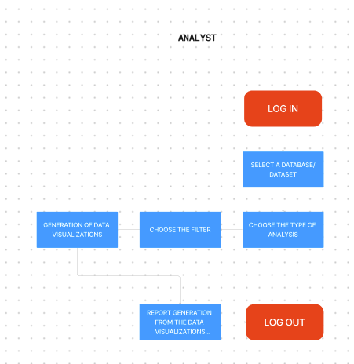
Documentation and Training:
Provide comprehensive documentation for system administrators, analysts, and end-users.
Offer training and onboarding resources for users to make effective.
PROJECT DESIGN
USER FLOW DIAGRAMS AND USER STORIES: User flow diagrams for an Indian food Exploratory Data Analysis (EDA) can help visualize how different users or personas interact with the system and navigate through the various stages of data exploration.

Slide 14
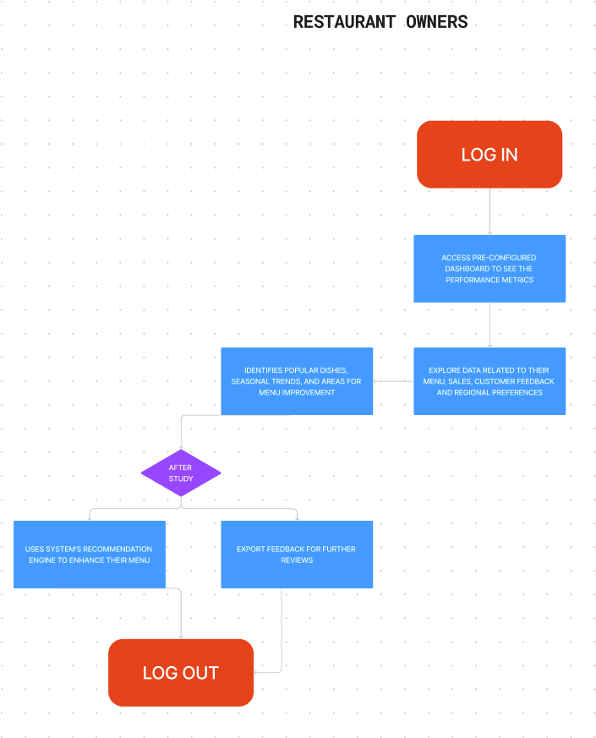

Slide 15
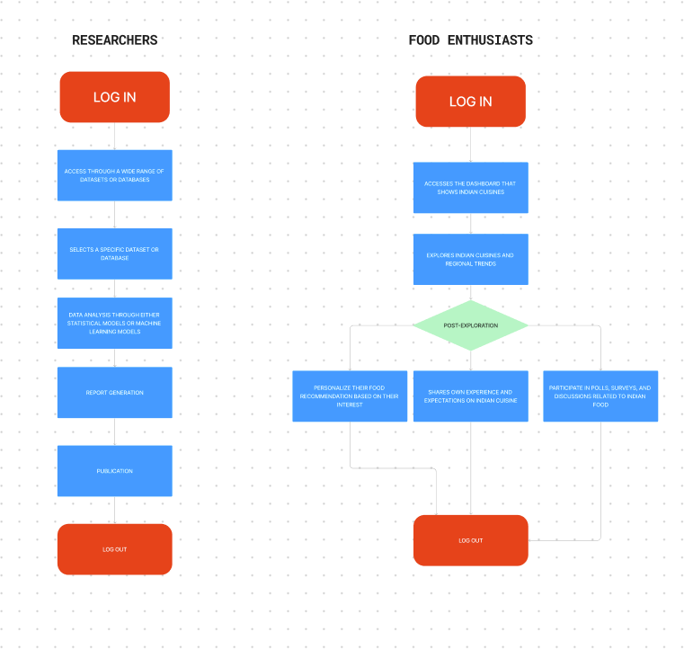

Slide 16
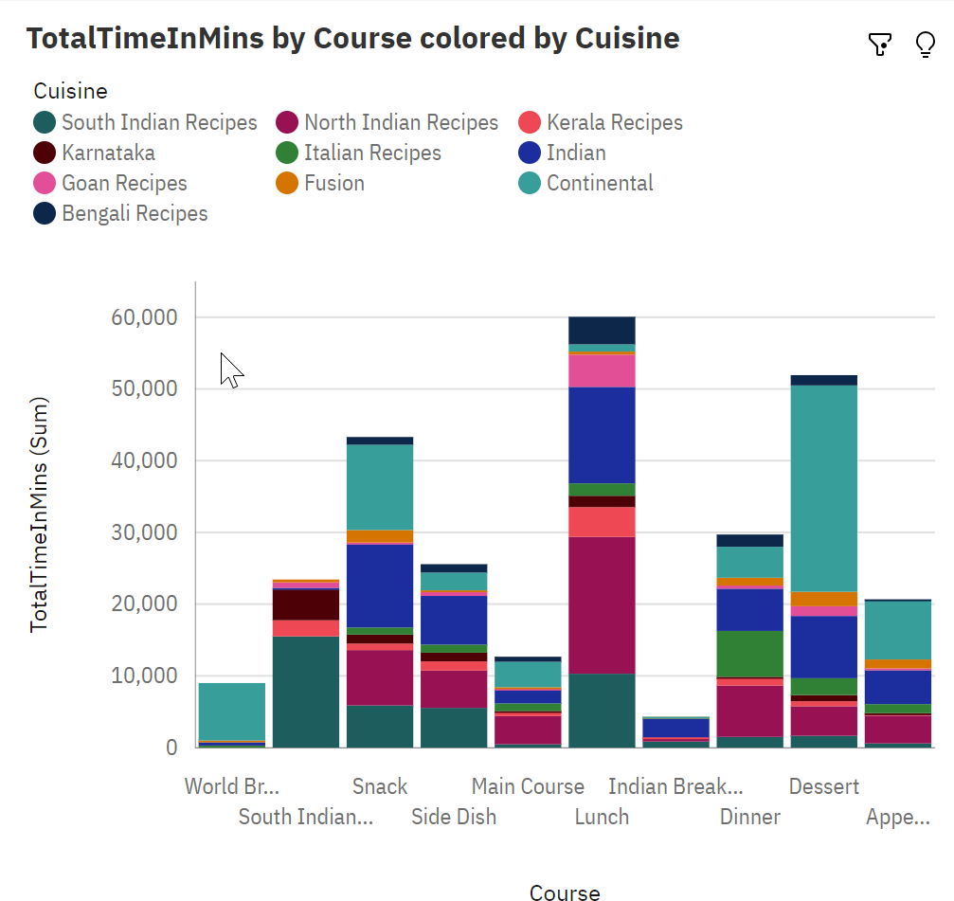
A data story is a way of presenting data and analysis in a narrative format, with the goal of making the information more engaging and easier to understand. A data story typically includes a clear introduction that sets the stage and explains the context for the data, a body that presents the data and analysis in a logical and systematic way, and a conclusion that summarizes the key findings and highlights their implications. Data stories can be told using a variety of mediums, such as reports, presentations, interactive visualizations, and videos.

Slide 17
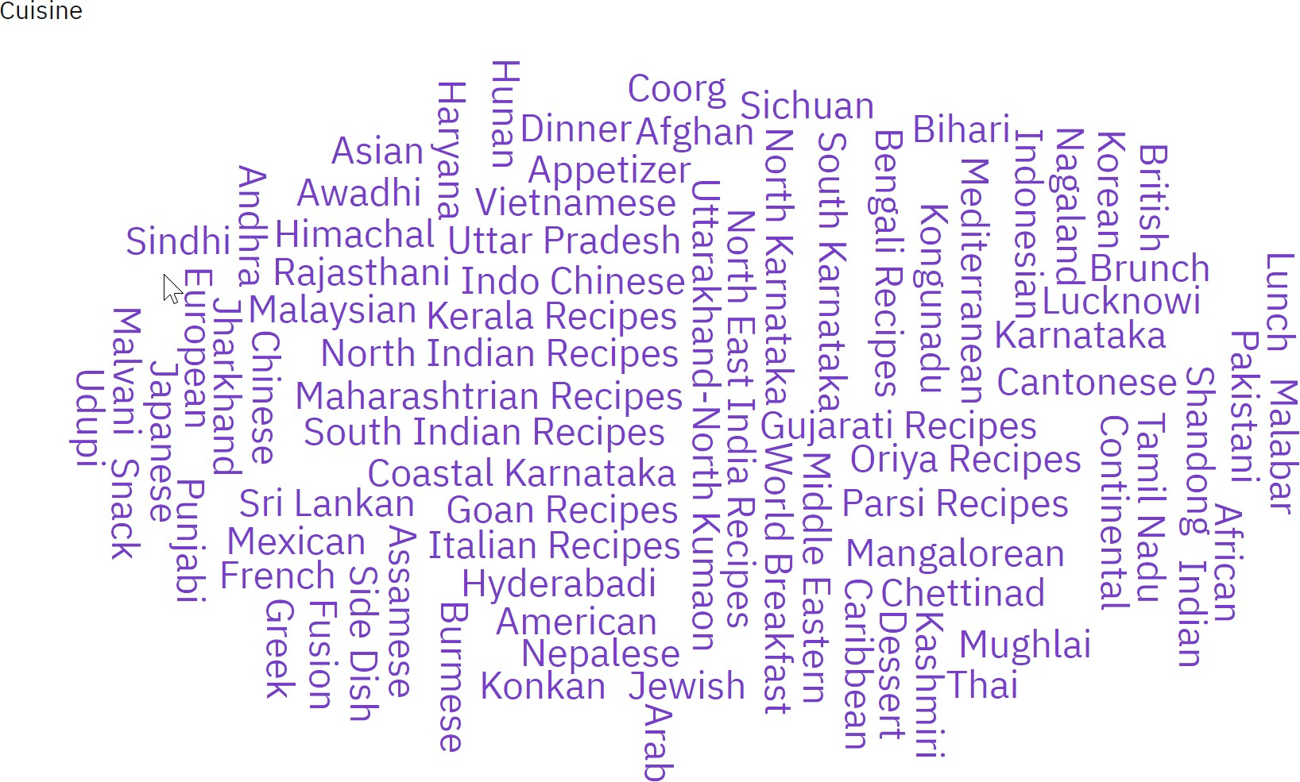

Slide 18
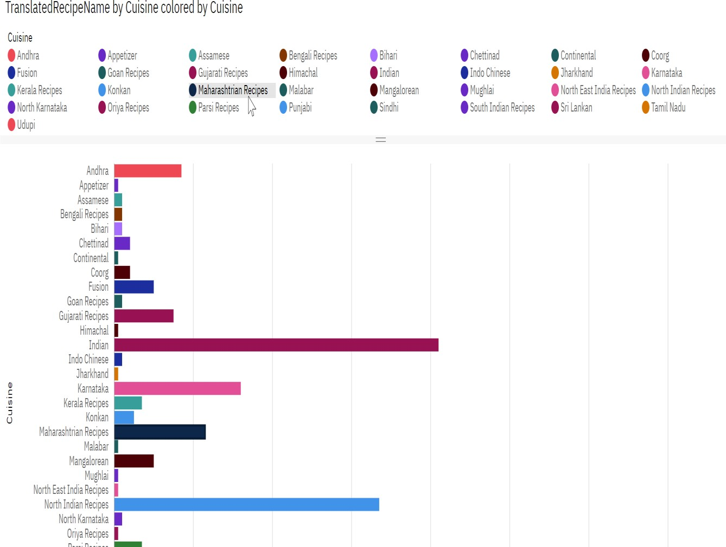

Slide 19
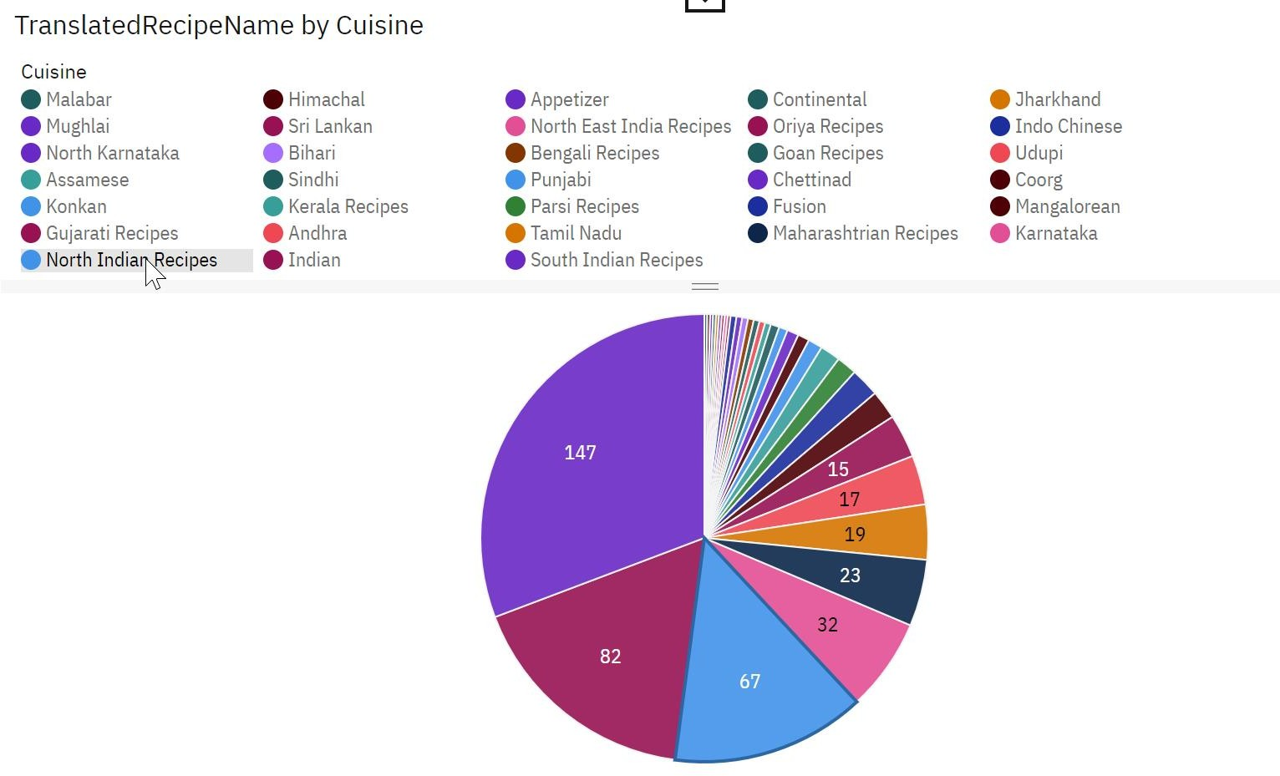

Slide 20
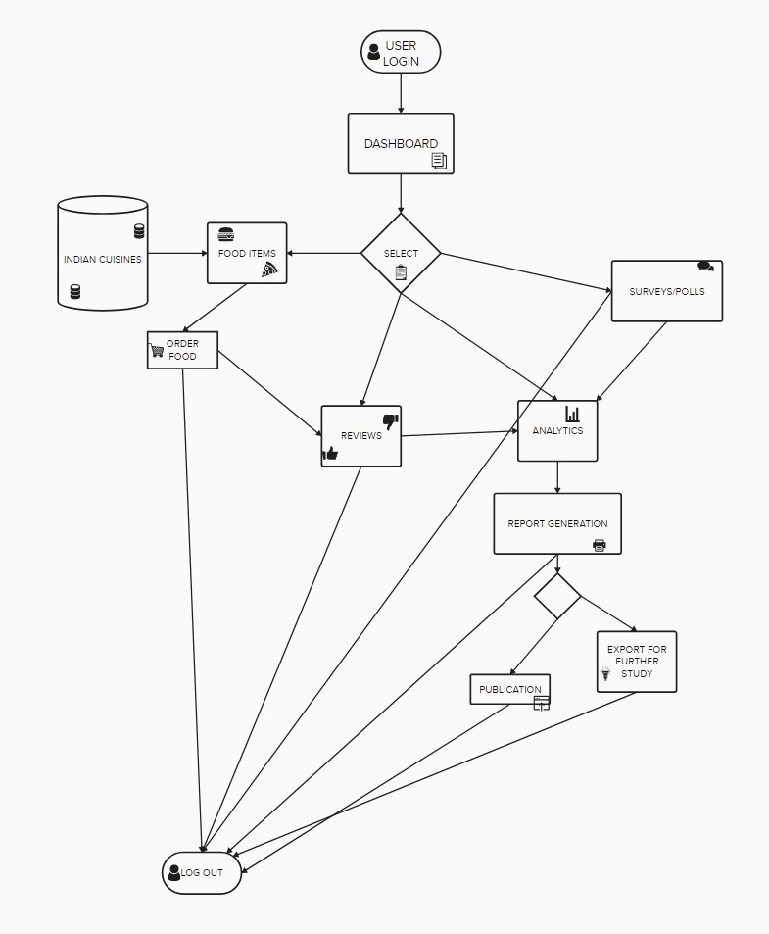
5.2. SOLUTION ARCHITECTURE
0

Slide 21
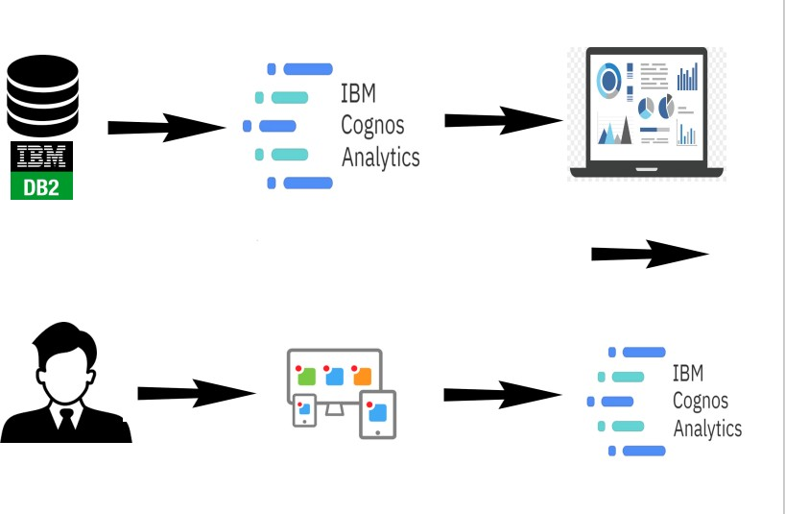
PROJECT PLANNING AND SCHEDULING
TECHNICAL ARCHITECTURE

Slide 22
6.2. SPRINT PLANNING AND SCHEDULING
Sprint planning and estimation for an Indian food Exploratory Data Analysis (EDA) project typically involves breaking down the project into smaller, time- bound iterations or sprints.
Project: Indian Food EDA
Total Project Duration: 6 months
Number of Sprints: 12 (2 weeks per sprint)
Sprint 1: Project Initiation (2 weeks)
Define project objectives and scope (3 days).
Assemble the project team (4 days).
Identify and gather initial data sources (5 days).
Sprint 2: Data Preparation (2 weeks)
Ingest and integrate data sources (6 days).
Data cleansing and preprocessing (7 days).
Establish data storage and indexing strategies (5 days).
Sprint 3: User Interface Design (2 weeks)
Design user interfaces and dashboards (9 days).
Implement basic authentication and authorization controls (3 days).
Sprint 4: Data Analysis Foundations (2 weeks)
Develop data analysis and visualization components (8 days).
Implement basic statistical analysis features (6 days).

Slide 23
Sprint 4: Data Analysis Foundations (2 weeks)
Develop data analysis and visualization components (8 days).
Implement basic statistical analysis features (6 days).
Sprint 5: Security and Compliance (2 weeks)
Strengthen data security measures and implement access controls (8 days).
Ensure compliance with data privacy regulations (6 days).
Sprint 6: Reporting and Export (2 weeks)
Develop reporting features with customizable templates (8 days).
Implement data export functionalities in various formats (6 days).
Sprint 7: Recommendation Engine (2 weeks)
Develop a recommendation engine using machine learning algorithms (8 days).
Begin integration of the recommendation engine (6 days).
Sprint 8: Scalability and Performance (2 weeks)
Optimize the system for scalability and performance (8 days).
Implement load balancing and caching mechanisms (6 days).

Slide 24
Sprint 9: Documentation and Training (2 weeks)
Create comprehensive documentation for users and administrators (8 days).
Develop training materials and resources (6 days).
Sprint 10: Monitoring and Analytics (2 weeks)
Set up monitoring tools for system performance and user activity tracking (9 days).
Implement analytics tools for gaining insights into user behavior (5 days).
Sprint 11: User Acceptance Testing (2 weeks)
Invite representative users to participate in user acceptance testing (8 days).
Gather feedback and make necessary adjustments (6 days).
Sprint 12: Deployment and Launch (2 weeks)
Deploy the EDA system to a production environment (6 days).
Perform final checks, security assessments, and launch the system (8 days).
6.3. SPRINT DELIVERY SCHEDULE
A sprint delivery schedule for an Indian food Exploratory Data Analysis (EDA) project outlines when specific features or functionalities will be delivered to stakeholders at the end of each sprint. Below is an example of a sprint delivery schedule for a 6-month Indian food EDA project with 12 sprints:

Slide 25
Sprint 1: Project Initiation (2 weeks)
Sprint Start Date: Month 1, Day 1
Sprint End Date: Month 1, Day 14
Delivery:
Definition of project objectives and scope.
Assembled project team.
Initial data sources identified and gathered.
Sprint 2: Data Preparation (2 weeks)
Sprint Start Date: Month 1, Day 15
Sprint End Date: Month 1, Day 28
Delivery:
Data sources ingested and integrated.
Data cleansing and preprocessing.

Slide 26
- Data storage and indexing strategies established.
Sprint 3: User Interface Design (2 weeks)
Sprint Start Date: Month 2, Day 1
Sprint End Date: Month 2, Day 14
Delivery:
Designed user interfaces and dashboards.
Basic authentication and authorization controls.
Sprint 4: Data Analysis Foundations (2 weeks)
Sprint Start Date: Month 2, Day 15
Sprint End Date: Month 2, Day 28
Delivery:
Data analysis and visualization components.
Basic statistical analysis features.
Sprint 5: Security and Compliance (2 weeks)
Sprint Start Date: Month 3, Day 1
Sprint End Date: Month 3, Day 14

Slide 27
Delivery:
Strengthened data security measures and access controls.
Compliance with data privacy regulations.
Sprint 6: Reporting and Export (2 weeks)
Sprint Start Date: Month 3, Day 15
Sprint End Date: Month 3, Day 28
Delivery:
Reporting features with customizable templates.
Data export functionalities in various formats.
Sprint 7: Recommendation Engine (2 weeks)
Sprint Start Date: Month 4, Day 1
Sprint End Date: Month 4, Day 14
Delivery:
Development of a recommendation engine using machine learning.
Integration of the recommendation engine begins

Slide 28
Sprint 8: Scalability and Performance (2 weeks)
Sprint Start Date: Month 4, Day 15
Sprint End Date: Month 4, Day 28
Delivery:
Optimized system for scalability and performance.
Implementation of load balancing and caching mechanisms.
Sprint 9: Documentation and Training (2 weeks)
Sprint Start Date: Month 5, Day 1
Sprint End Date: Month 5, Day 14
Delivery:
Comprehensive documentation for users and administrators.
Development of training materials and resources.

Slide 29
Sprint 10: Monitoring and Analytics (2 weeks)
Sprint Start Date: Month 5, Day 15
Sprint End Date: Month 5, Day 28
Delivery:
Monitoring tools for system performance and user activity tracking.
Implementation of analytics tools for user behavior insights.
Sprint 11: User Acceptance Testing (2 weeks)
Sprint Start Date: Month 6, Day 1
Sprint End Date: Month 6, Day 14
Delivery:
User acceptance testing with gathered feedback.
Sprint 12: Deployment and Launch (2 weeks)
Sprint Start Date: Month 6, Day 15
Sprint End Date: Month 6, Day 28
Delivery:
Deployment of the EDA system to a production environment.
Final checks, security assessments, and system launch.

Slide 30
7. RESULT

Slide 31
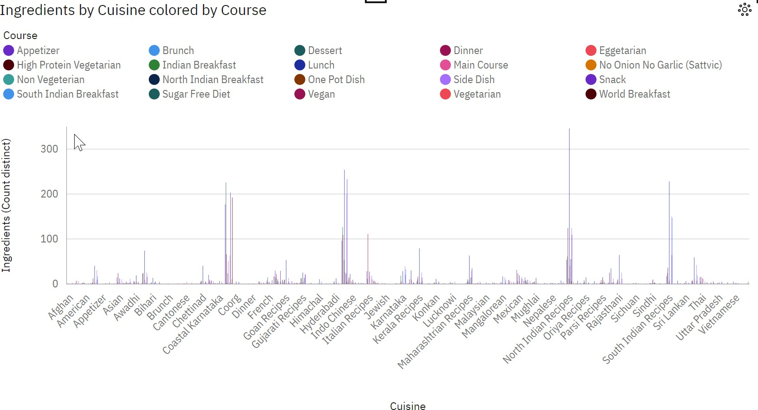

Slide 32
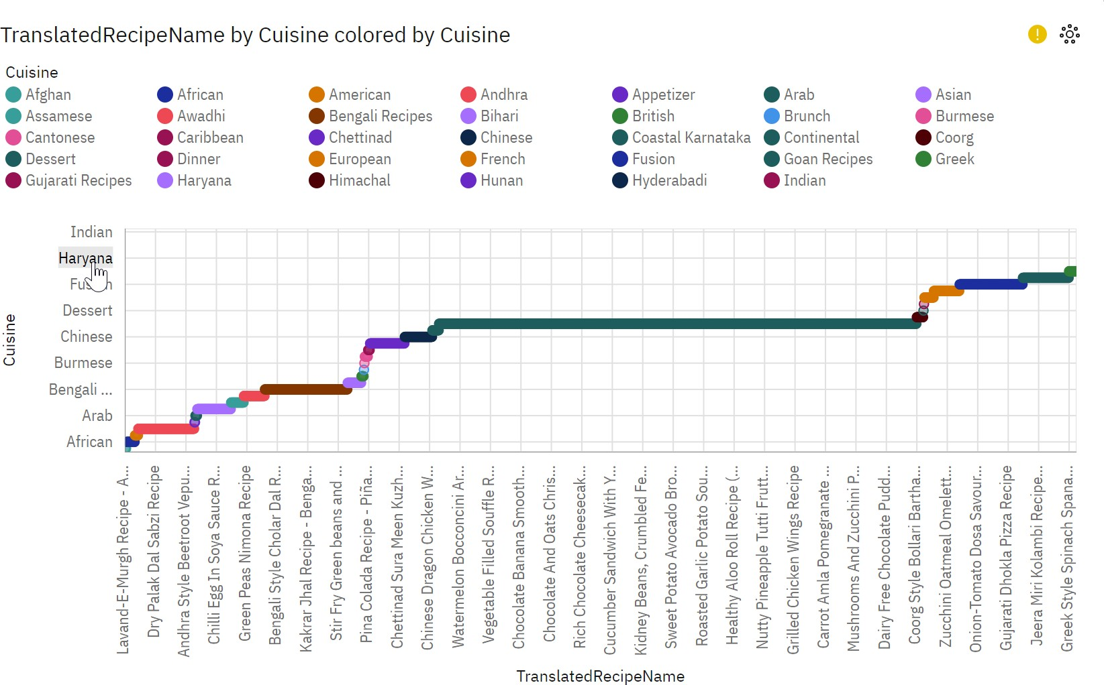

Slide 33
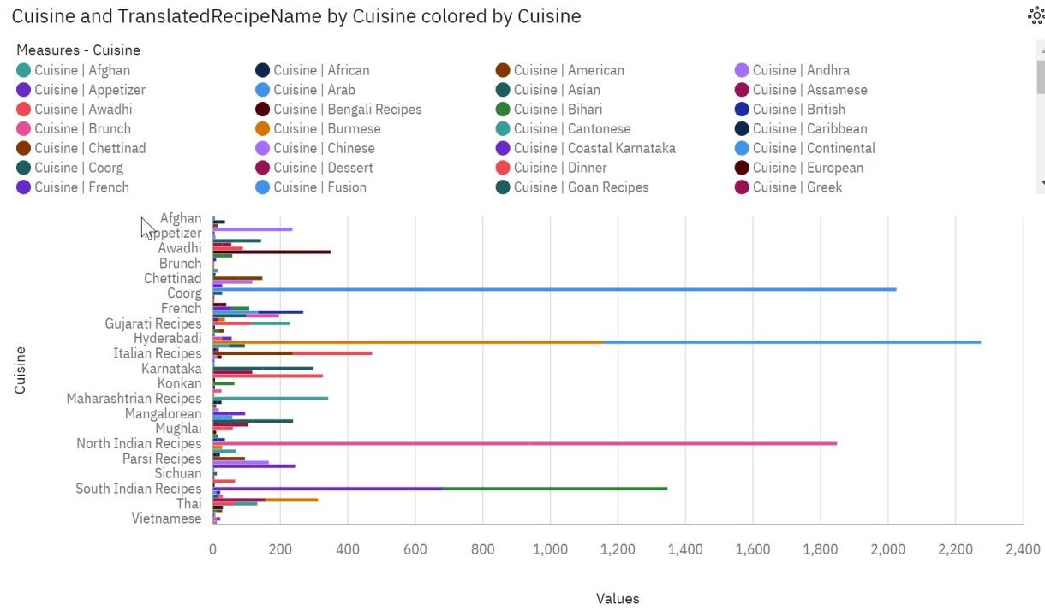

Slide 36
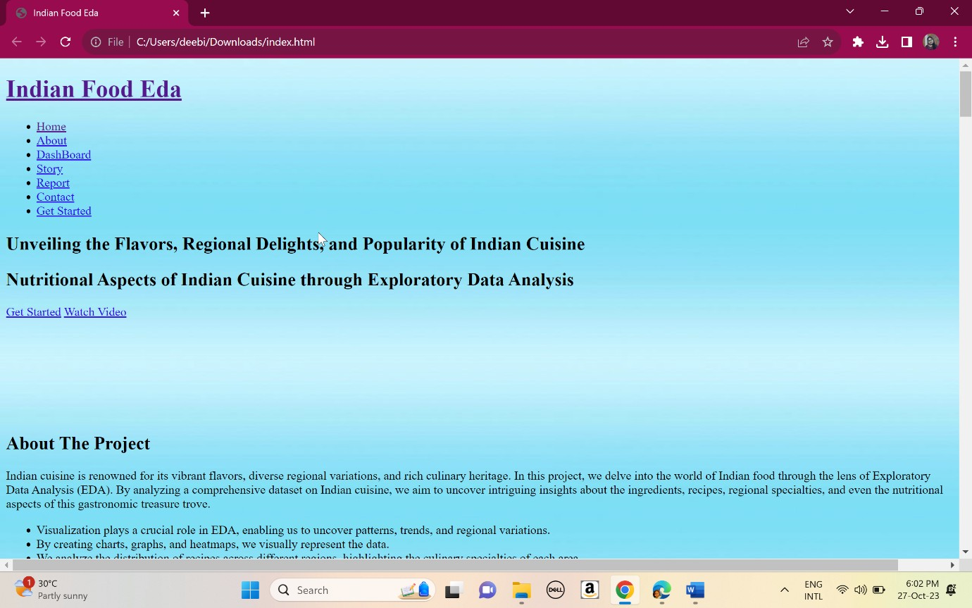

Slide 37
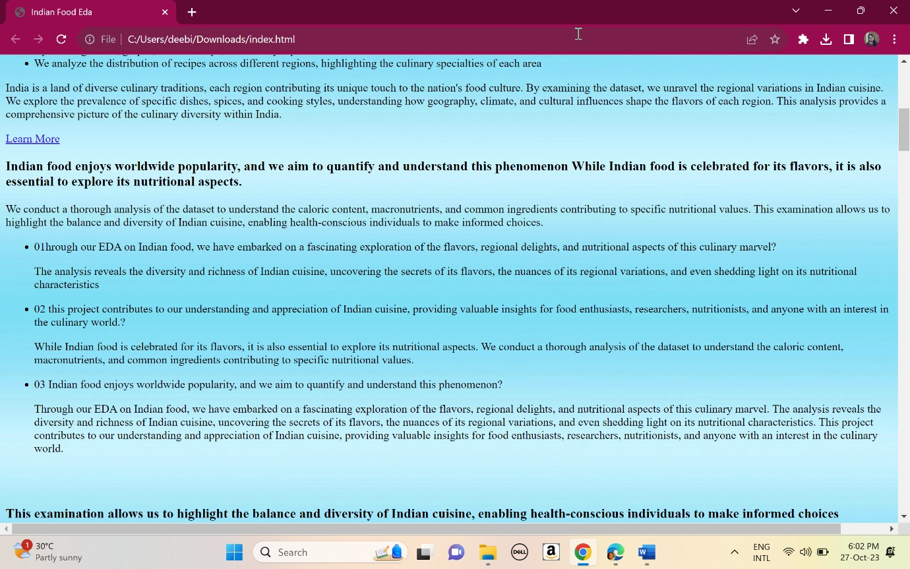

Slide 38
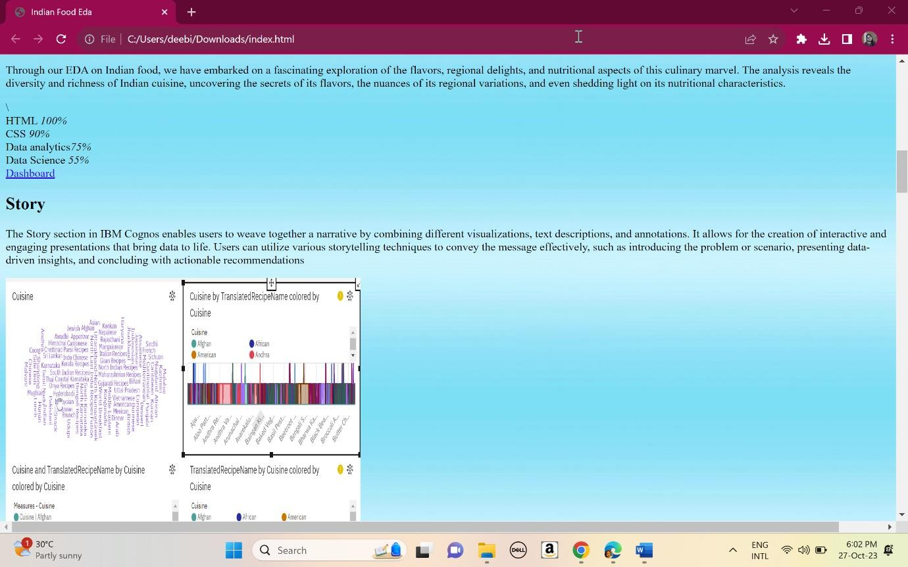

Slide 39
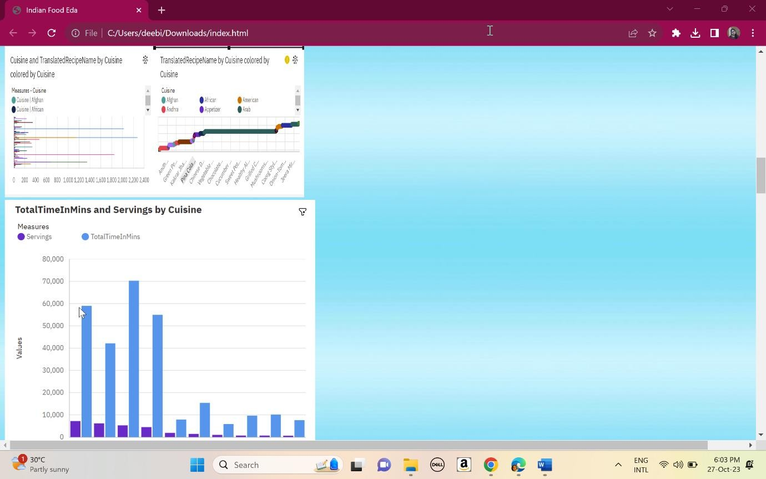

Slide 40
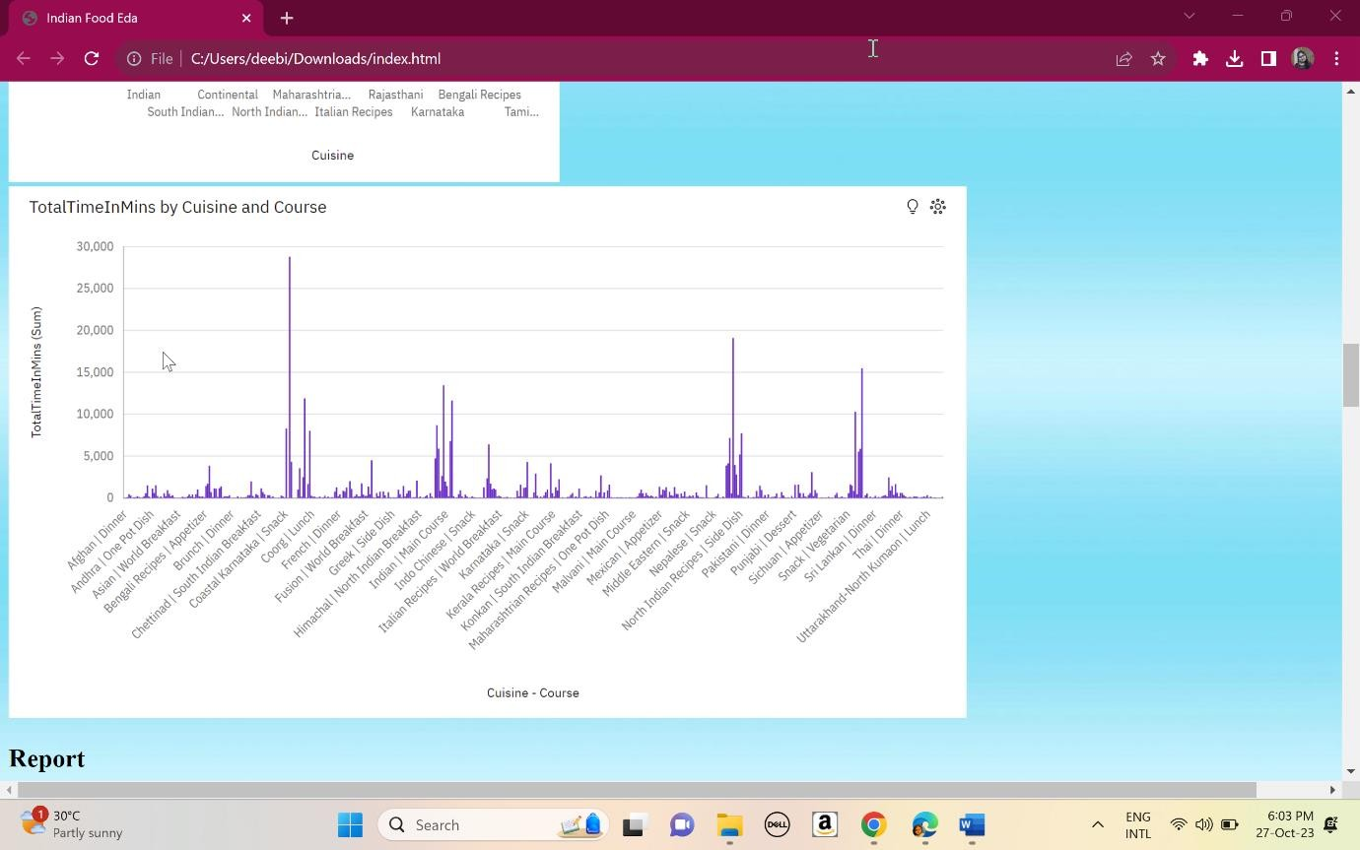

Slide 41
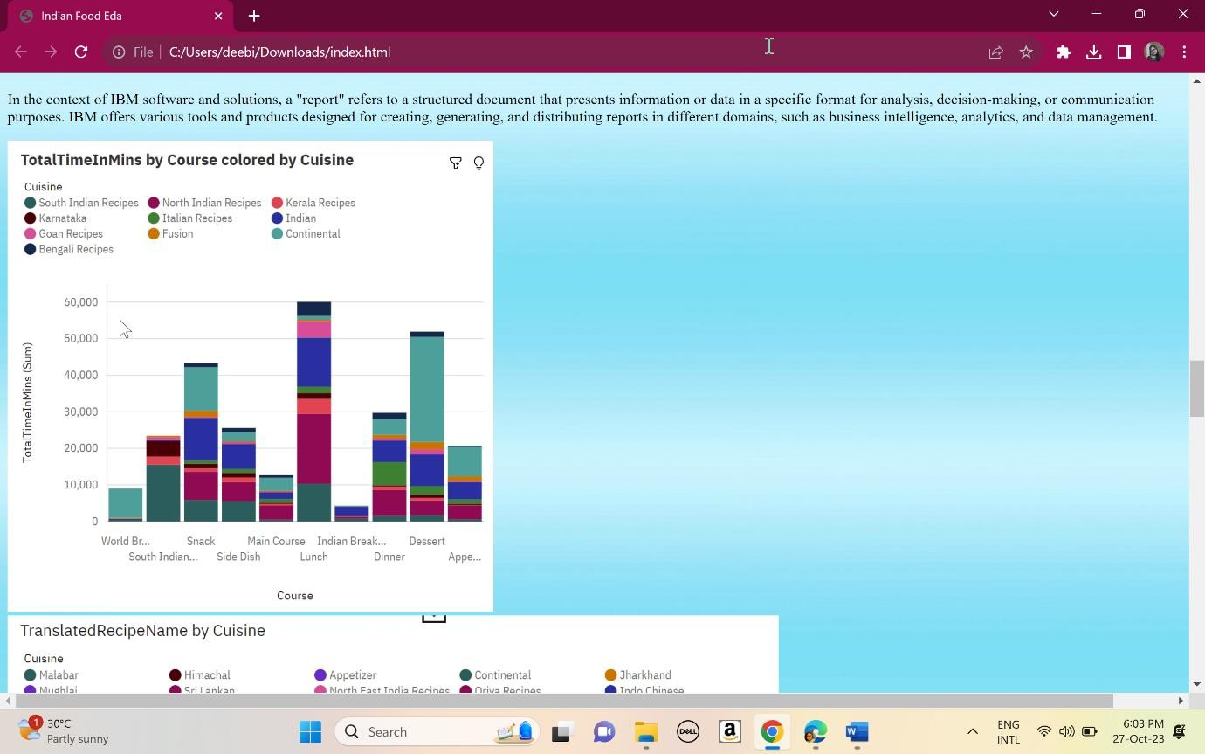

Slide 42
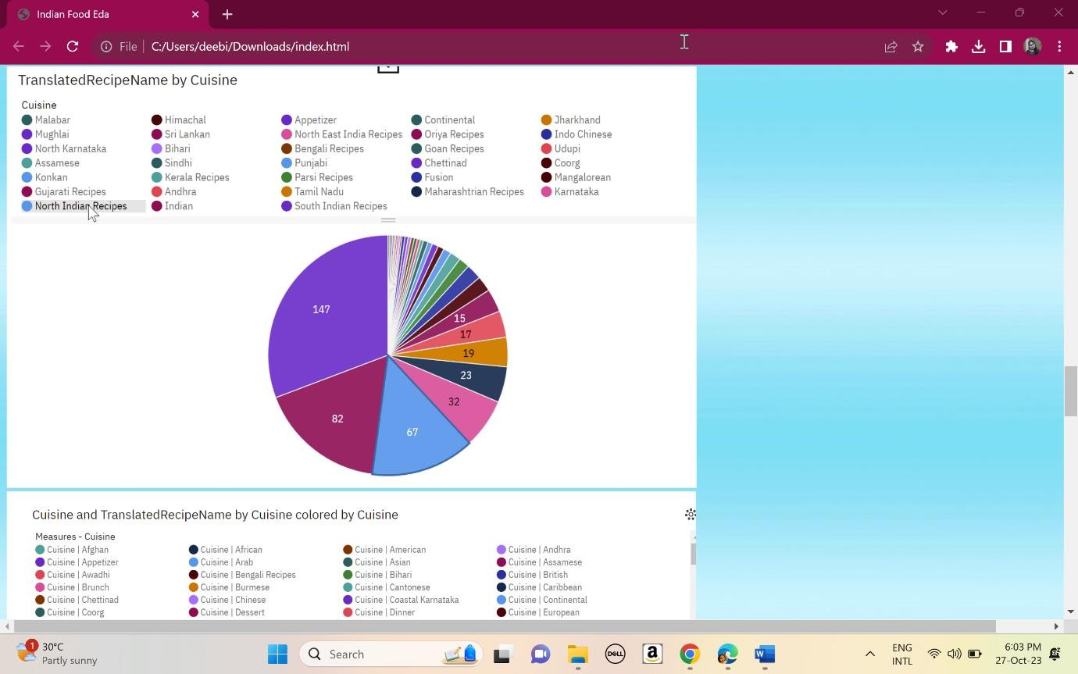

Slide 43
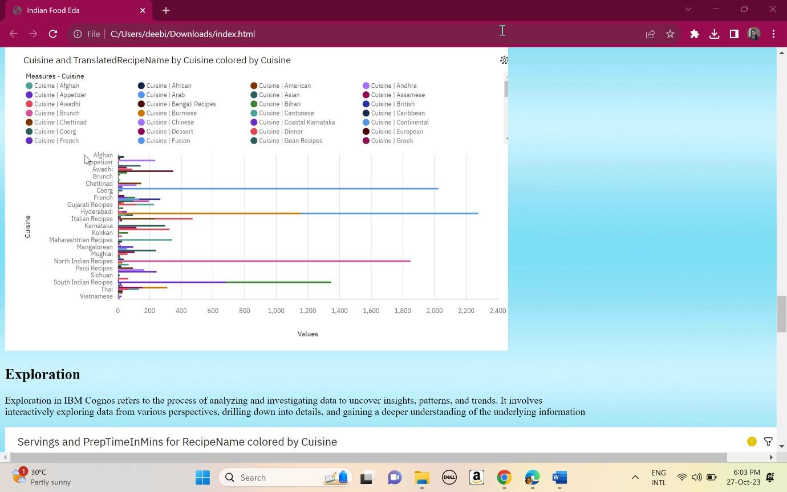

Slide 44
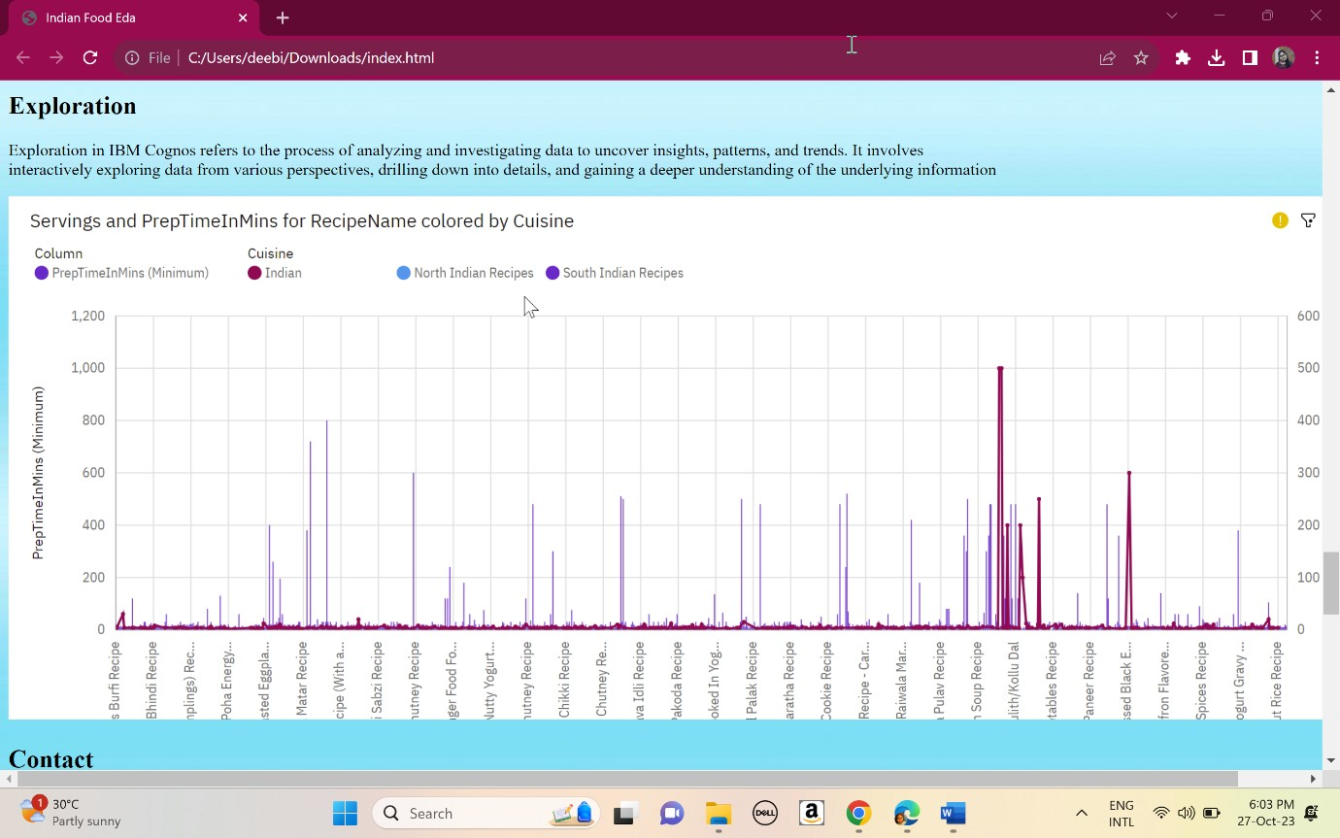

Slide 45
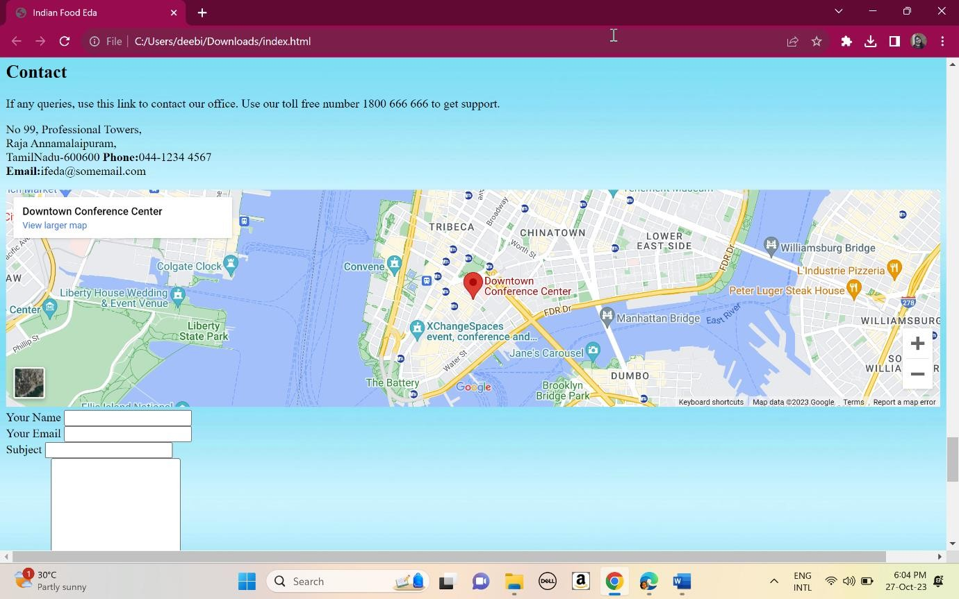

Slide 46
CONCLUSION
The EDA on Indian food dataset provides valuable insights into the characteristics, variations, and popularity of Indian cuisine. The analysis helps in understanding the diversity of Indian food, identifying key ingredients, regional variations, and popular dishes. These insights can be useful for culinary enthusiasts, food researchers, nutritionists, and even restaurant owners looking to understand Indian cuisine better or develop new recipes.

